Slide 1
Employment management system
By
Bharath A
43611026
be cse aiml

Slide 2
ABstract
The Employment Management System is a web-based application designed to simplify the process of managing employee details within an organization. It allows administrators to add, update, and delete employee records, manage departments, assign job roles, and monitor attendance efficiently. The system is built using React.js for the frontend, Spring Boot for the backend, and MongoDB as the database to ensure fast and secure data handling. By automating routine tasks and maintaining digital records, this project helps reduce manual effort, minimize errors, and improve overall management efficiency in the workplace.

Slide 3
EXISTING SYSTEM
in the existing system, most companies still manage their employee records manually using paper files or simple excel sheets. this process takes a lot of time and effort. when data needs to be updated or searched, it becomes difficult and confusing. sometimes, important employee information can be lost or entered incorrectly. also, there is no proper link between departments, so communication becomes slow. because of this, overall management of employees — like attendance, salary, and performance tracking — becomes inefficient and less accurate.

Slide 4
Proposed system
The proposed system is an Employment Management System that helps organizations manage all employee-related data in a digital and efficient way. This system uses React for the front end, Spring Boot for the backend, and MongoDB as the database to store all employee details safely. It allows the admin to add, update, delete, and view employee records easily. It also helps in tracking attendance, job details, and performance quickly without any manual work. By using this system, companies can save time, reduce errors, and improve accuracy in managing employees. The system also ensures that all information is secure and easily accessible whenever needed.

Slide 5
ADVANTAGES
Easy Data Management – Stores and updates employee details quickly.
Time Saving – Reduces manual paperwork and speeds up processes.
User Friendly – Simple interface made with React for smooth use.
Accurate Records – Minimizes human errors in employee information.
Secure Storage – Uses MongoDB for safe and reliable data handling.
Scalable System – Can be easily expanded as the organization grows.

Slide 6
disadvantage
Internet Dependency – The system requires an active internet connection to work.
Initial Setup Cost – Needs installation and setup of tools like MongoDB and servers.
Technical Knowledge Required – Users need basic computer and software knowledge.
Data Security Risks – If not properly secured, data could be vulnerable to cyber threats.
Maintenance Needed – Regular updates and backups are necessary to keep it running smoothly.

Slide 7
HARDWARE REQUIREMENTS
Processor: Intel i3 or above
RAM: Minimum 4 GB
Hard Disk: 250 GB or more
Monitor: Standard display
Keyboard and Mouse: Standard input devices
Internet Connection: Needed for database and backend access

Slide 8
Software requirements
Operating System: Windows 10 or above
Frontend: React.js
Backend: Spring Boot (Java)
Database: MongoDB
Server: Apache Tomcat (embedded)
Tools: VS Code, IntelliJ IDEA or Eclipse
Build Tool: Maven
Browser: Google Chrome or any modern browser

Slide 9
modules
Employee Module: Manage employee details.
Department Module: Handle departments and assignments.
Attendance Module: Track daily attendance.
Payroll Module: Calculate and manage salaries.
Admin Module: Control and monitor the system.
Authentication Module: Secure login and access

Slide 10
Module description
Employee Module: Stores and manages employee information like name, ID, role, and contact details.
Department Module: Organizes employees under different departments and handles related data.
Attendance Module: Records employees’ daily attendance and working hours.
Payroll Module: Calculates employee salaries based on attendance and other factors.
Admin Module: Allows the admin to manage users, update records, and control the system.
Authentication Module: Provides secure login and logout features for all users.

Slide 11
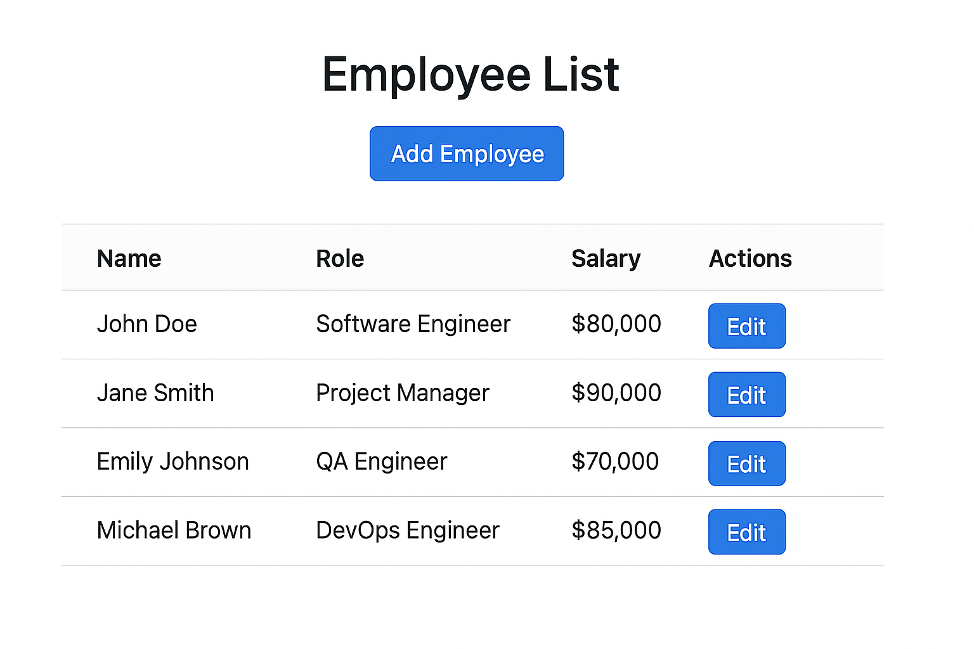
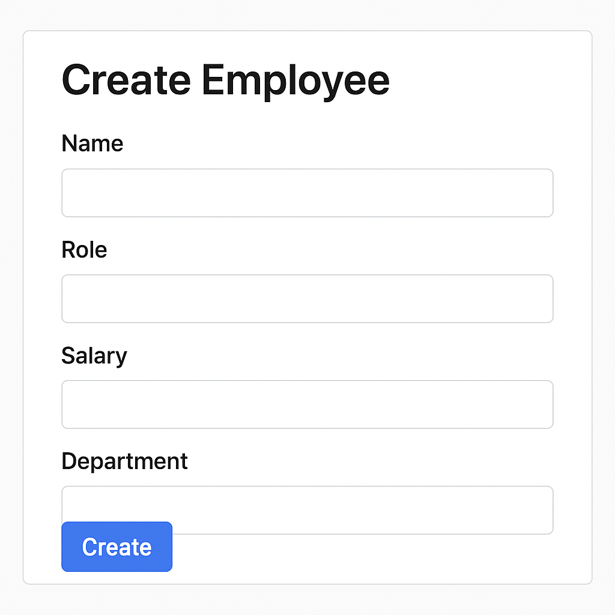
Sample output

Slide 12
conclusion
The Employment Management System simplifies the process of managing employee information by providing a centralized and automated platform. It reduces manual work, improves data accuracy, and makes employee tracking more efficient. With the integration of Java Spring Boot, React, and MongoDB, this system ensures better performance, easy access, and smooth user interaction. Overall, the project helps organizations save time, minimize errors, and maintain well-organized employee records effectively.

